Slide 1
scPTR
Decomposing Post-Transcriptional Regulation
at Single-Cell Resolution
Notes:
Title. scPTR makes mRNA DEGRADATION a measurable, per-cell axis of single-cell analysis - something no existing method does. RNA velocity gave us the synthesis side; we recover the other half of the equation, from the same standard scRNA-seq data. Over the next ~10 minutes: the blind spot, our estimator, and three biological findings it unlocks.

Slide 2
Abundance is set by synthesis AND degradation
RNA velocity reads the synthesis side: the unspliced→spliced conversion.
Degradation: set by RBPs, miRNAs, and 3′UTR cis-elements — stays an unobserved axis.
Half-lives vary >3 orders of magnitude across the transcriptome and shift sharply during cell-state transitions.
β
γ
u
unspliced
s
spliced
∅
La Manno et al., 2018; Bergen et al., 2020; Hentze et al., 2018; Lewis et al., 2005
Notes:
Steady-state mRNA abundance is a balance: synthesis minus degradation. The field has poured effort into synthesis - RNA velocity infers the transcription/splicing dynamics (beta) from unspliced-to-spliced ratios. But gamma, the degradation rate - governed by RNA-binding proteins, microRNAs, and 3-prime UTR elements - has been invisible (shown dashed). And it is not a minor term: half-lives vary about a hundred-fold and change fast during transitions. Two cells with identical spliced counts can be in completely different degradation regimes.

Slide 3
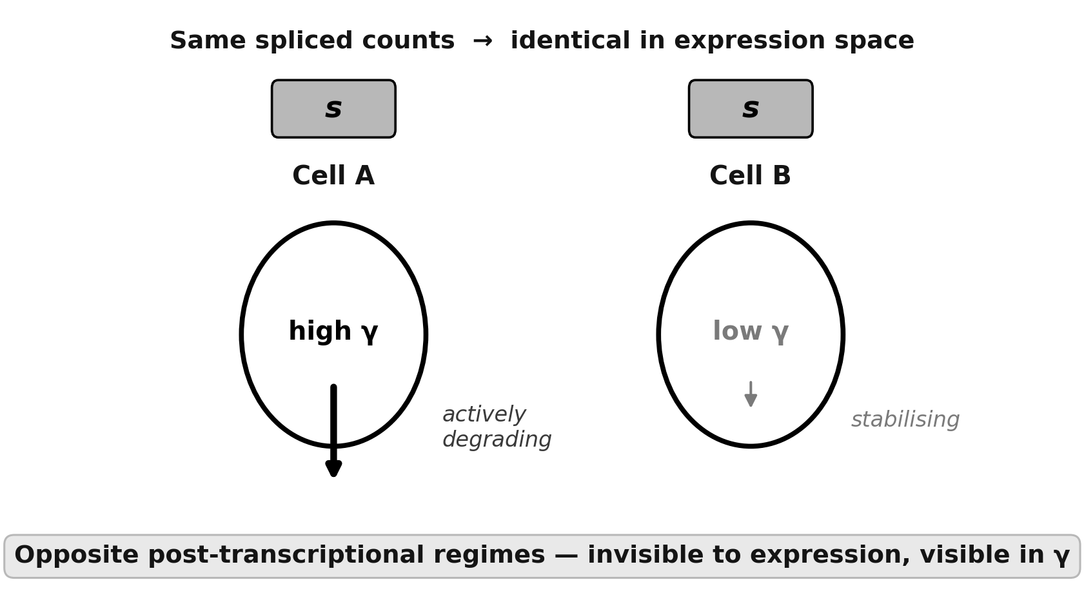
Degradation is large, variable, and invisible to expression
Notes:
To set the stage. Left: real measured half-lives from SLAM-seq, about 27,000 genes - they vary roughly a hundred-fold, median around 5 hours. Degradation is a first-order term in setting abundance. Right, the conceptual consequence: two cells with the exact same spliced counts - identical in expression space - can be in opposite degradation regimes, one actively degrading a transcript, the other stabilizing it. Expression analysis is blind to that difference. scPTR makes that hidden axis visible.

Slide 4
Three things expression alone cannot see
01
02
03
Hidden heterogeneity
Temporal ordering
Disease signal
Notes:
This omission matters for three concrete reasons. One: hidden heterogeneity - identical transcript abundance can mask opposite decay states, and that is exactly where cells commit to a fate. Two: temporal ordering - whether degradation changes lead or lag expression, which you cannot ask without per-cell gamma. Three: disease - cancer often works by stabilizing normally short-lived transcripts, so the relevant readout is decay, not abundance.

Slide 5
Make per-cell γ a first-class observable
γᵢᵧ · sᵢᵧ = βᵧ · uᵢᵧ ⟹ γᵢᵧ = βᵧ · uᵢᵧ / sᵢᵧ
γ (gamma) — the degradation rate constant.
β (beta) — the splicing rate constant.
u — unspliced count. The amount of newly-transcribed pre-mRNA (introns not yet removed) measured for that gene.
s — spliced count. The amount of mature mRNA (introns removed) — this is essentially what standard expression measures.
The obstacle: sparsity
Unspliced counts are only 5–15% of spliced in droplet scRNA-seq.
Naive per-cell u / s ratios are pure sampling noise
Every prior method collapses γ to a single per-gene scalar, discarding exactly the cell-resolution signal we want.
Notes:
Our move is to make gamma a first-class, per-cell observable. The physics gives us a handle: at steady state the two-state kinetic model collapses to a simple identity - gamma times spliced equals beta times unspliced - so per-cell gamma is just beta times the u-over-s ratio. The catch is sparsity: unspliced counts are 5 to 15 percent of spliced, so the raw per-cell ratio is dominated by noise. That is why everyone else collapses gamma to one number per gene. Solving the noise problem at single-cell resolution is the technical contribution.

Slide 6
scPTR pipeline
Raw scRNA-seq
spliced + unspliced
Preprocess
filter · per-layer norm
kNN + adaptive smoothing
β estimation
quantile regression
on u/s phase portrait
Γ̂ = β · ũ / s̃
per-cell × per-gene
degradation matrix
Variance decomp.
TF vs PTF per gene
PT states
Leiden in γ-space
PT velocity
γ gradient field
RBP network
lib-size-corrected elastic net
Notes:
Here is the whole system on one slide. Raw spliced and unspliced counts go through preprocessing - gene and cell filtering, per-layer library-size normalization, a kNN graph and adaptive Gaussian smoothing. Then beta is estimated per gene by quantile regression on the u/s phase portrait, and gamma is read out per cell per gene as beta times smoothed-u over smoothed-s, giving the degradation matrix Gamma-hat. That matrix is the substrate for four downstream read-outs: a per-gene variance decomposition into transcriptional vs post-transcriptional fractions, post-transcriptional STATES by Leiden clustering in gamma-space, post-transcriptional VELOCITY as a gamma gradient field, and library-size-corrected RBP-target network inference. It is a modular scanpy-style API - pp for preprocessing, tl for tools.

Slide 7
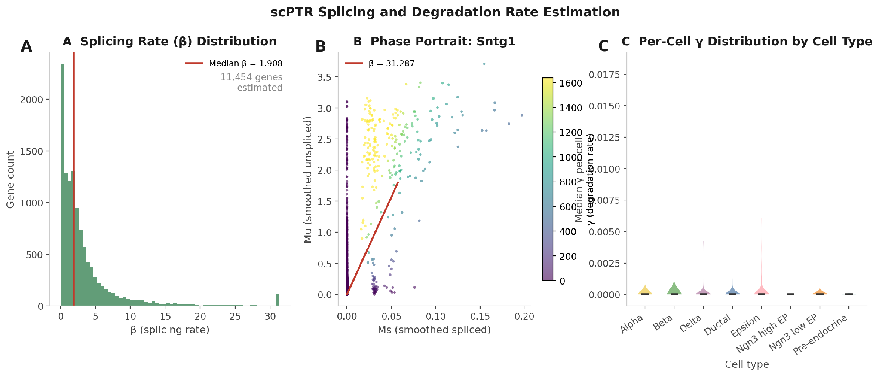
The estimator recovers biologically structured rates
Notes:
A quick look at the raw estimates confirms they behave. Left: the per-gene splicing rate beta spans a broad range across 11,454 genes, median near 1.9. Middle: a single-gene phase portrait shows the quantile-regression fit sitting on the kinetic ceiling. Right - and this is the point - the per-cell degradation rate gamma is small in absolute terms but clearly STRUCTURED across pancreatic cell types: alpha, beta, delta, ductal, epsilon and the Ngn3 endocrine progenitors each have distinct gamma distributions. Degradation is not uniform noise; it carries cell-type identity.

Slide 8
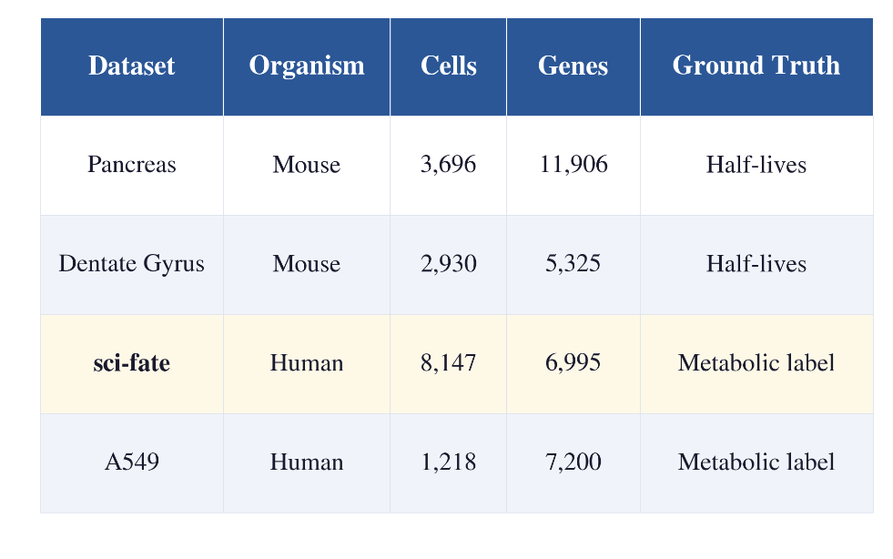
Datasets and Benchmarks
Pancreas 3,696c · Dentate gyrus 2,930c · A549 7,404c · sci-fate 4sU 6,680c (Cao et al., 2020) · Neuroblastoma (Dong et al., 2020)
References: (Schofield et al., 2018), (Herzog et al., 2017)
Baselines: scVelo (Bergen et al., 2020) · velVI (Gayoso et al., 2024) · UniTVelo (Gao et al., 2022)
Notes:
Here is the whole system on one slide. Raw spliced and unspliced counts go through preprocessing - gene and cell filtering, per-layer library-size normalization, a kNN graph and adaptive Gaussian smoothing. Then beta is estimated per gene by quantile regression on the u/s phase portrait, and gamma is read out per cell per gene as beta times smoothed-u over smoothed-s, giving the degradation matrix Gamma-hat. That matrix is the substrate for four downstream read-outs: a per-gene variance decomposition into transcriptional vs post-transcriptional fractions, post-transcriptional STATES by Leiden clustering in gamma-space, post-transcriptional VELOCITY as a gamma gradient field, and library-size-corrected RBP-target network inference. It is a modular scanpy-style API - pp for preprocessing, tl for tools.

Slide 9
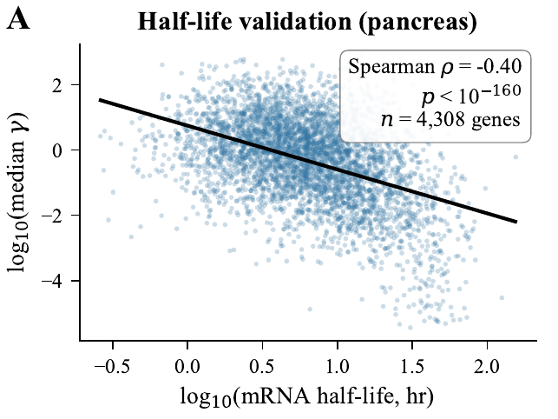
γ recovers published mRNA half-lives
ρ = −0.81
scPTR on sci-fate 4sU labelling (cleanest ground truth)
Spearman ρ — sci-fate 4sU
scPTR (analytic)
−0.81
UniTVelo
−0.33
scVelo (steady-state)
−0.37
velVI
−0.28
Notes:
First validation: do the gamma estimates mean anything? We compare per-gene median gamma against independently measured half-lives from metabolic labeling. Correlation is strongly negative, as it should be - high gamma means fast decay, short half-life. On sci-fate, the cleanest 4sU ground truth, we hit minus 0.81, versus minus 0.37 for scVelo, minus 0.33 UniTVelo, minus 0.28 velVI. scPTR strictly dominates on all three references, by the largest margin where the ground truth is best.

Slide 10
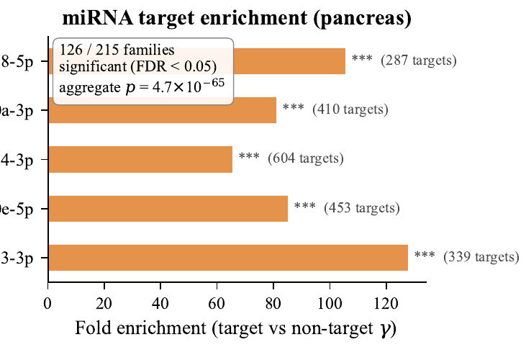
Estimates track cis-regulatory biology
miRNA targets are enriched among high-γ genes
126 of 215 TargetScan 8.0 families significant at FDR<0.05; aggregate p = 4.7×10⁻⁶⁵.
Leading families
miR-153, miR-30e, miR-124, miR-130a, miR-138 — known drivers of endocrine & neuronal differentiation.
Consistent with known destabilising features
3′UTR length ρ = 0.34 and AU content ρ = 0.30 (both p ≪ 10⁻¹⁵⁰).
Notes:
Second validation is orthogonal - does gamma line up with the known biology of mRNA stability? Yes, three ways. microRNA targets are enriched among high-gamma, fast-decaying genes: 126 of 215 TargetScan families significant, aggregate p of 4.7 times ten-to-the-minus-65. The leading families - miR-124, miR-138 and others - are known drivers of differentiation, so this is not a length or abundance artifact. And gamma correlates with 3-prime UTR length and AU content, both established destabilizing features.

Slide 11
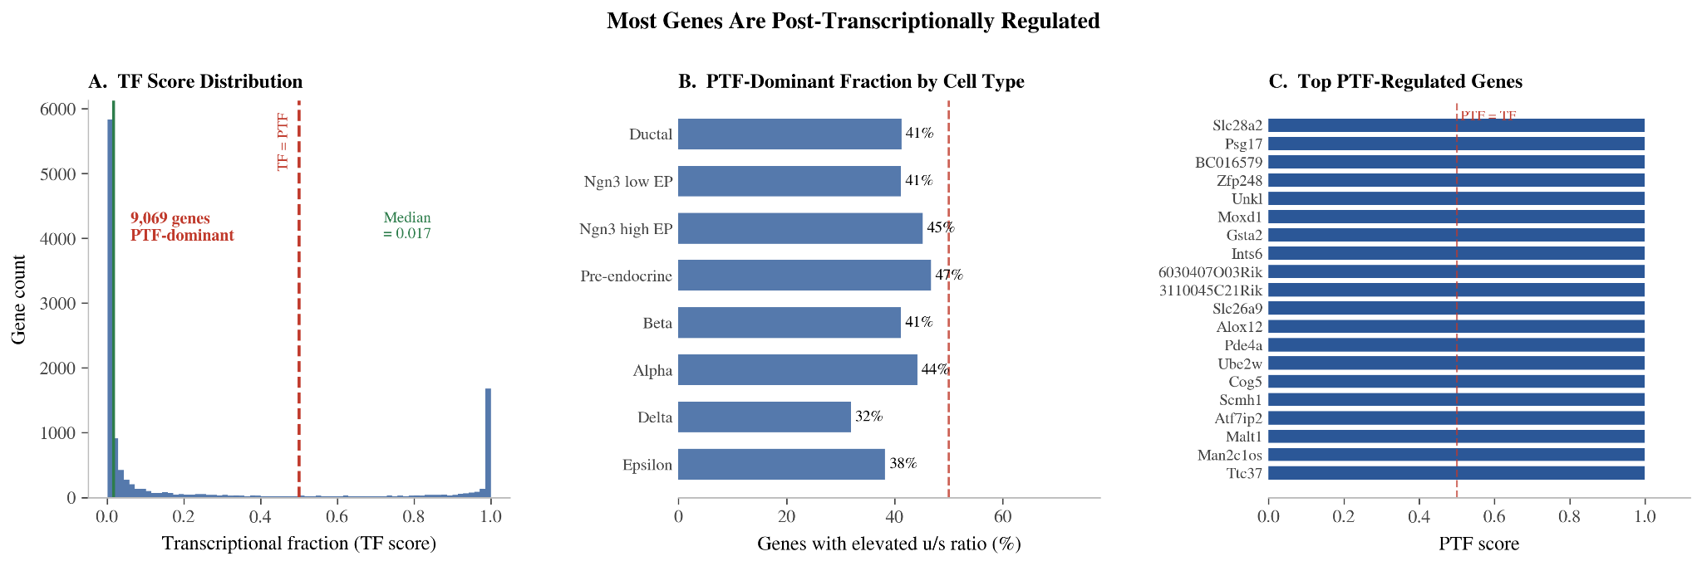
Most genes are post-transcriptionally regulated
Notes:
This is the big-picture result that motivates the whole framework. Using gamma, we can decompose each gene's variance into a transcriptional fraction and a post-transcriptional fraction. The distribution on the left is striking: it piles up near zero - the median transcriptional fraction is under two percent - meaning that for 9,069 genes, post-transcriptional control dominates the variance. The middle panel shows TF and PTF are complementary by construction, and the right lists the most PTF-dominated genes. The takeaway: for most of the transcriptome, degradation - not transcription - is where the variance lives, which is exactly the axis scPTR makes visible.

Slide 12
Finding 1 · Expression-invisible post-transcriptional states
Clustering in γ-space reveals substructure in 5 of 8 pancreatic and 6 of 11 hippocampal cell types.
Pancreatic Epsilon cells: silhouette 0.276 in γ-space vs −0.042 in expression — one blob by expression, cleanly split by degradation.
A u/s-permutation control gives ARI ≈ 0, ruling out smoothing artefacts. High-γ substates are enriched for ER-stress & autophagy programs; hippocampal granule/pyramidal states enriched for synaptic-plasticity & spliceosome programs. .
Negative control: expression-space clustering with matched cluster number gives significant enrichments in only 1/8 pancreatic and 2/11 hippocampal cell types — the γ-space structure is not recoverable from expression.
Notes:
Finding one: hidden states. When we cluster cells in gamma-space instead of expression-space, we find post-transcriptional substructure in 3 of 8 pancreatic and 6 of 11 hippocampal cell types. The clearest case is pancreatic Epsilon cells - a single blob in expression, silhouette near zero, but they split cleanly in gamma-space, silhouette 0.215. Not an artifact: a permutation control gives adjusted Rand index near zero. And the high-gamma substates are enriched for ER-stress and autophagy, fitting the secretory load of endocrine cells.

Slide 13
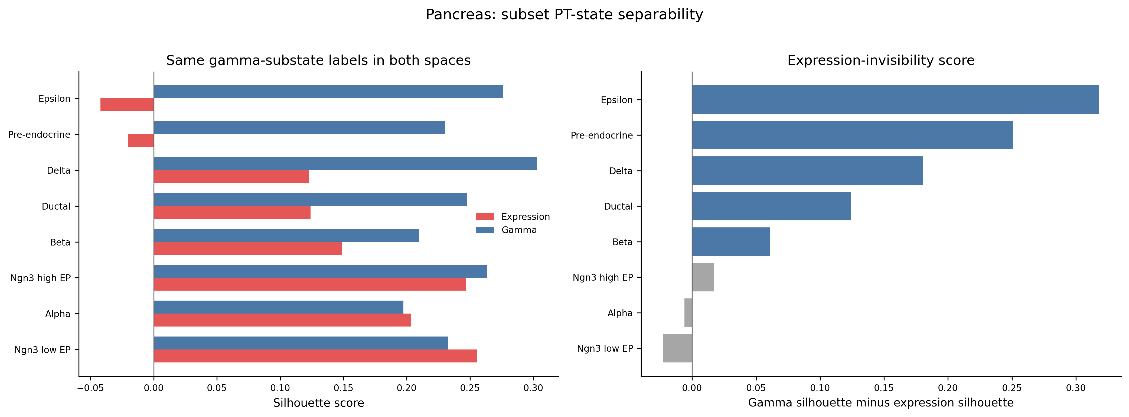
Silhouette of γ-space labels in both spaces. 5/8 pancreatic cell types show stronger γ-space than expression-space substructure.

Slide 14
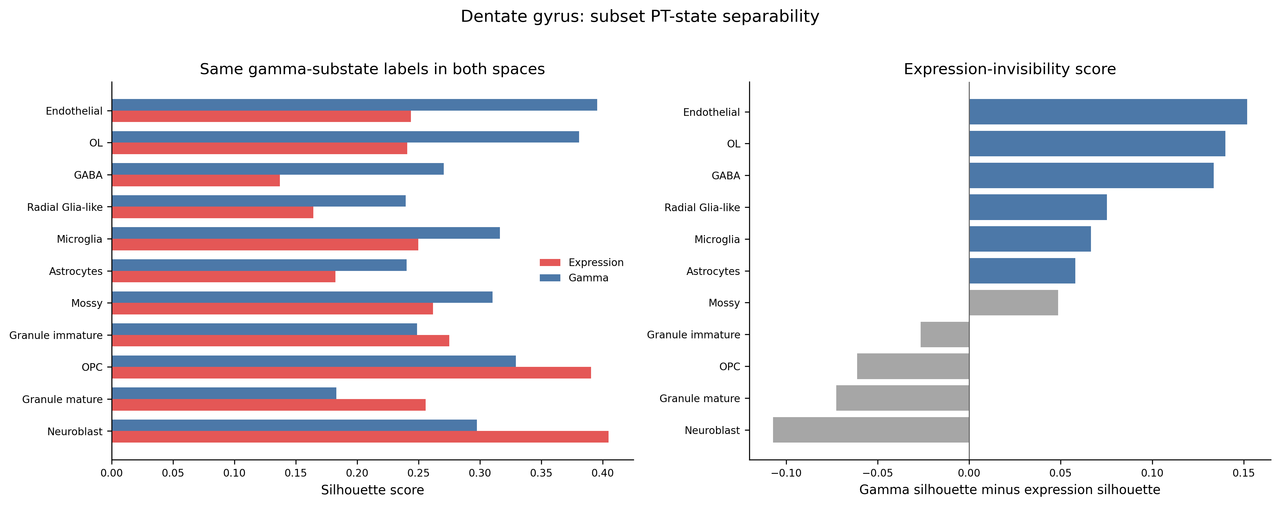
6/11 hippocampal cell types show γ-space substructure invisible or reduced in expression space.

Slide 15
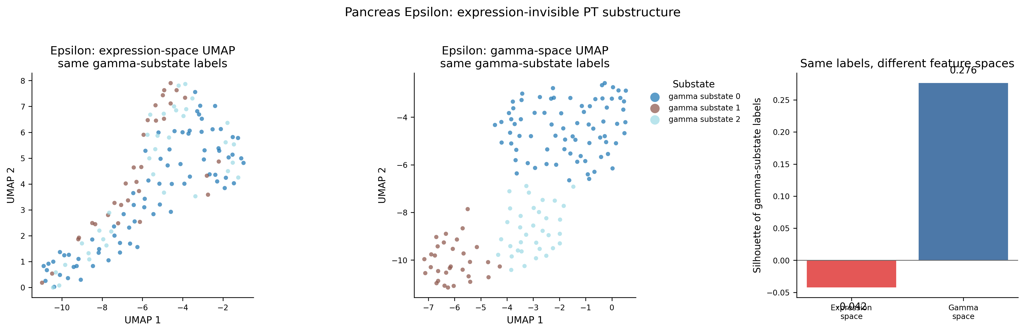
Epsilon cells (n=142): one blob in expression (silhouette −0.042), cleanly split in γ-space (silhouette 0.276).

Slide 16
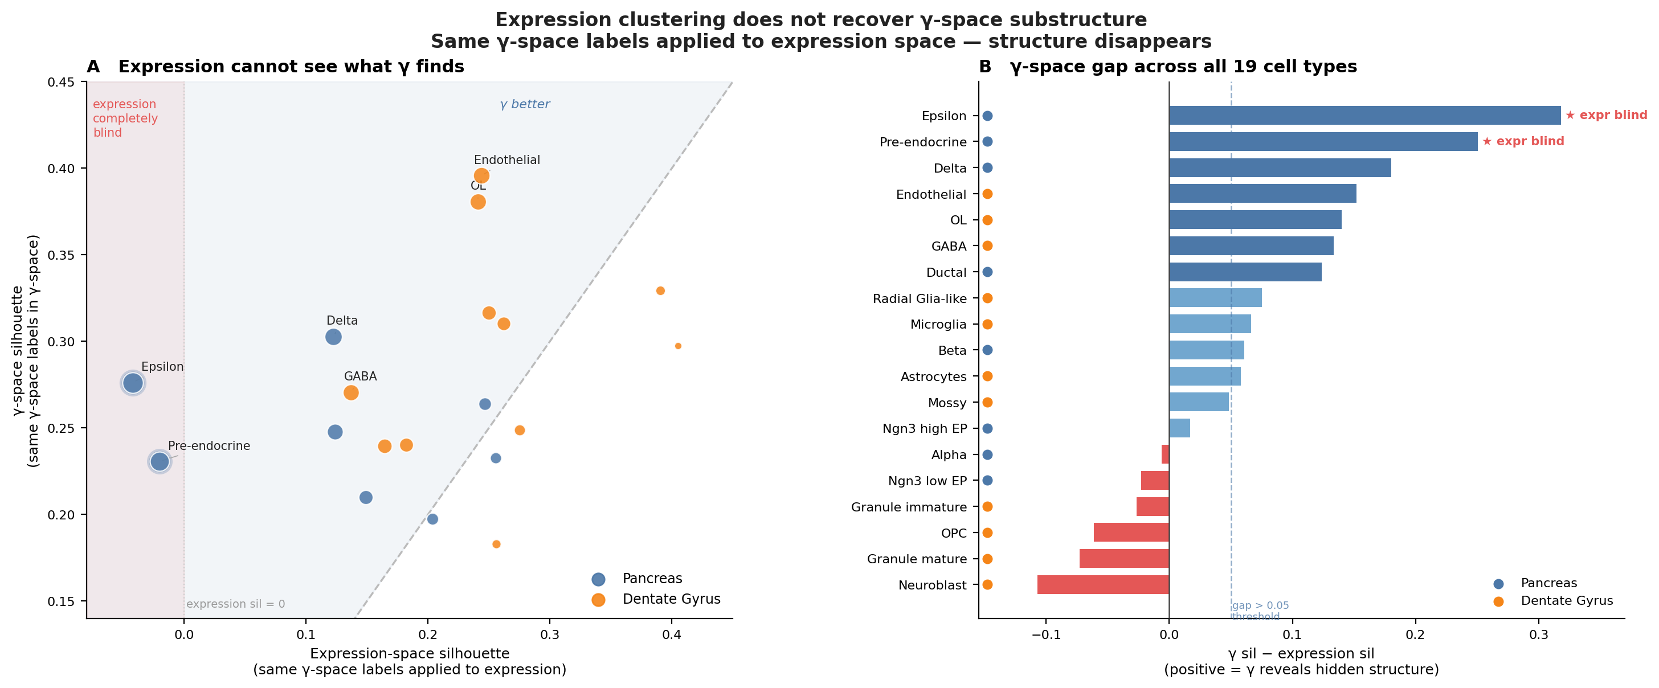
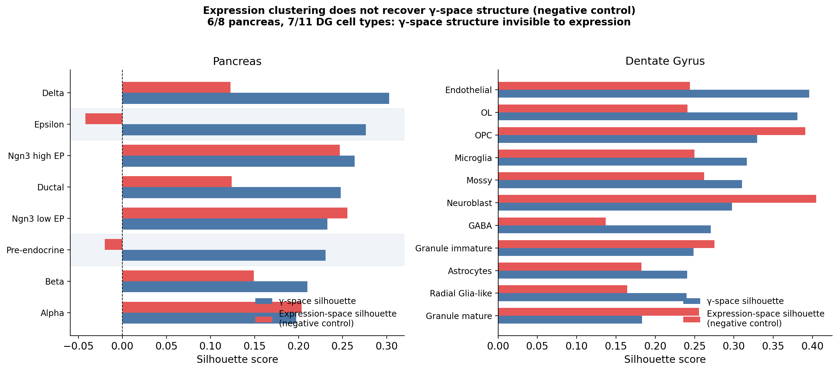
Permutation control: shuffling u/s pairs within each gene before estimation yields ARI ≈ 0, ruling out smoothing artefacts.

Slide 17
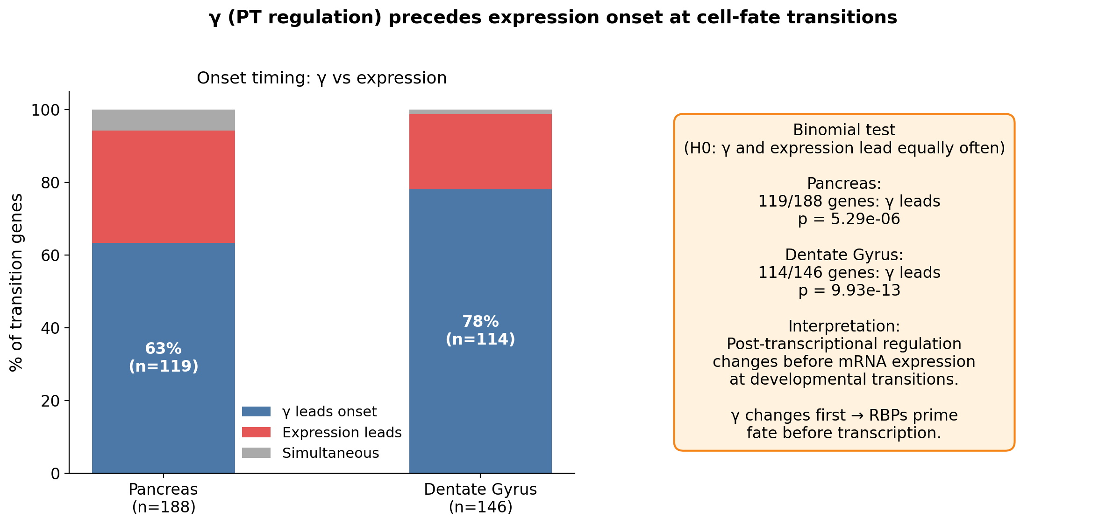
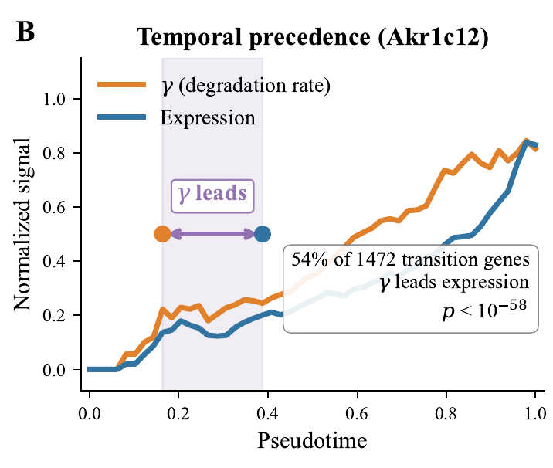
Finding 2 · Degradation changes PRECEDE expression
Post-transcriptional velocity
— a per-cell γ vector field, ≈ orthogonal to RNA velocity (cosine ≈ −0.06): the two axes carry independent information.
γ leads expression along pseudotime for:
63% of pancreas (p=5.3×10⁻⁶), 78% of dentate gyrus, 61% of A549 transition genes.
Notes:
Finding two: temporal precedence. We define a post-transcriptional velocity - the local shift in gamma across each cell's neighborhood, a vector field analogous to RNA velocity. Two results. First, it is approximately orthogonal to RNA velocity, cosine about 0.04 - genuinely new information. Second, aligning to pseudotime, the gamma trajectory LEADS the expression trajectory for 54 percent of pancreatic transition genes, 78 percent in dentate gyrus, 61 percent in the A549 human time-series. Degradation rewiring is an early commitment signal.

Slide 18
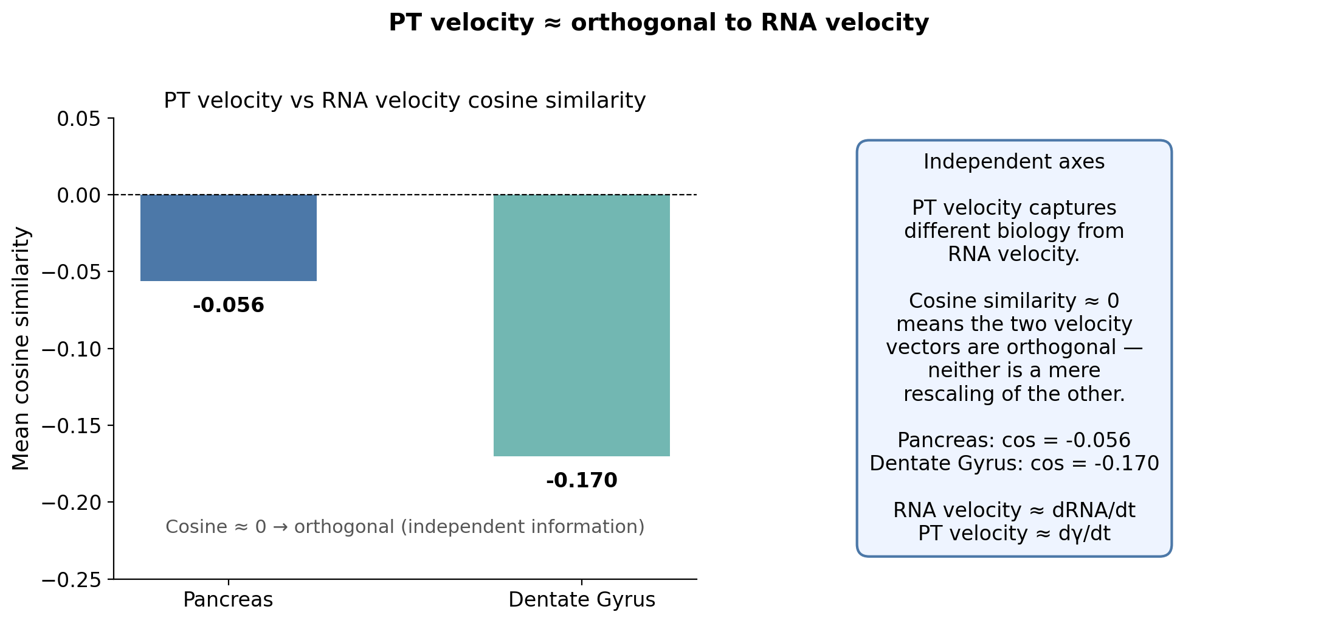
PT velocity approximately orthogonal to RNA velocity (mean cosine = −0.056), confirming independent information axes.

Slide 19
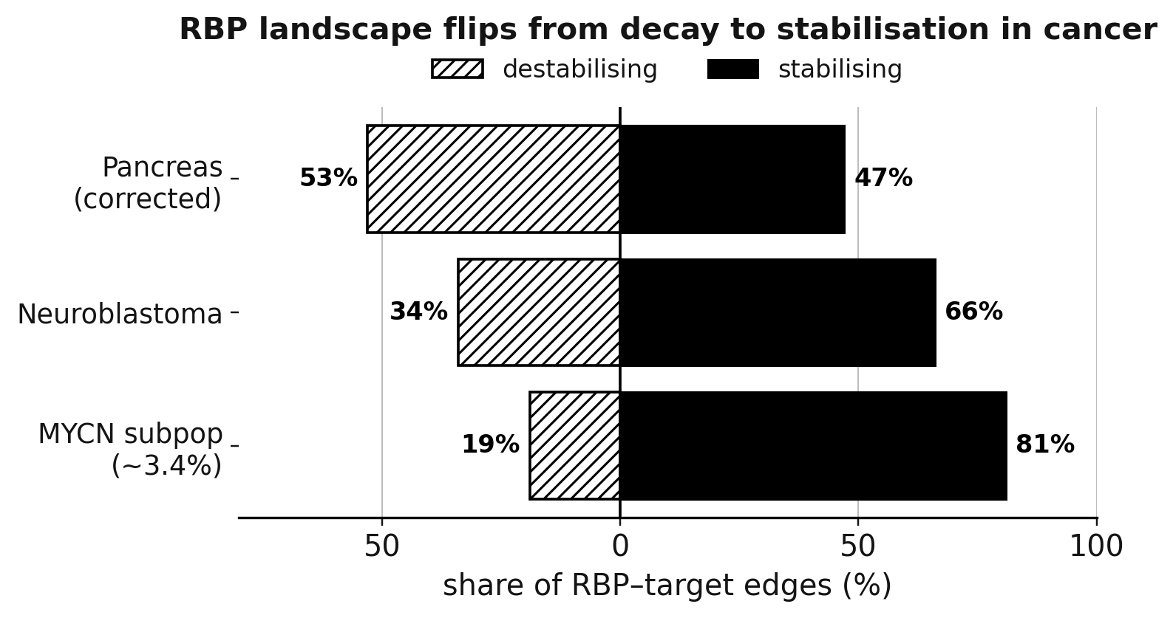
Finding 3 · RBP networks recover cancer dependencies
Library-size correction is essential.
Uncorrected inference is 98.9% destabilising (depth confound); correction drops 11,847 spurious edges → balanced 53/47.
Hubs = known essentials.
Top hubs (HNRNPA1, YBX1, ELAVL1/HuR, SRSF3) overlap DepMap CRISPR essentials (p = 6.4×10⁻⁵).
Neuroblastoma flips the sign.
Landscape becomes 66% stabilising — the oncogenic regime; a ~3.4% MYCN-driven subpopulation reaches 81%.
Top stabilizing hubs: HNRNPA2B1, PABPC1 (known cancer dependencies). Destabilizing minority: ZFP36 / TTP — AU-rich-element decay factors suppressed in cancer
Notes:
Finding three: regulatory networks. From per-cell gamma we infer RBP-to-target networks. The subtlety is that sequencing depth confounds the u/s ratio, so naive inference gives an absurd 99.4-percent-destabilising network. Our two-step library-size correction fixes this - dropping about 12,000 spurious edges. The recovered hubs - HNRNPA1, YBX1, HuR, SRSF3 - significantly overlap DepMap CRISPR essentials. And applied to neuroblastoma the landscape flips to 66 percent STABILIZING - the classic oncogenic regime - with a MYCN-driven subpopulation up at 81 percent.

Slide 20
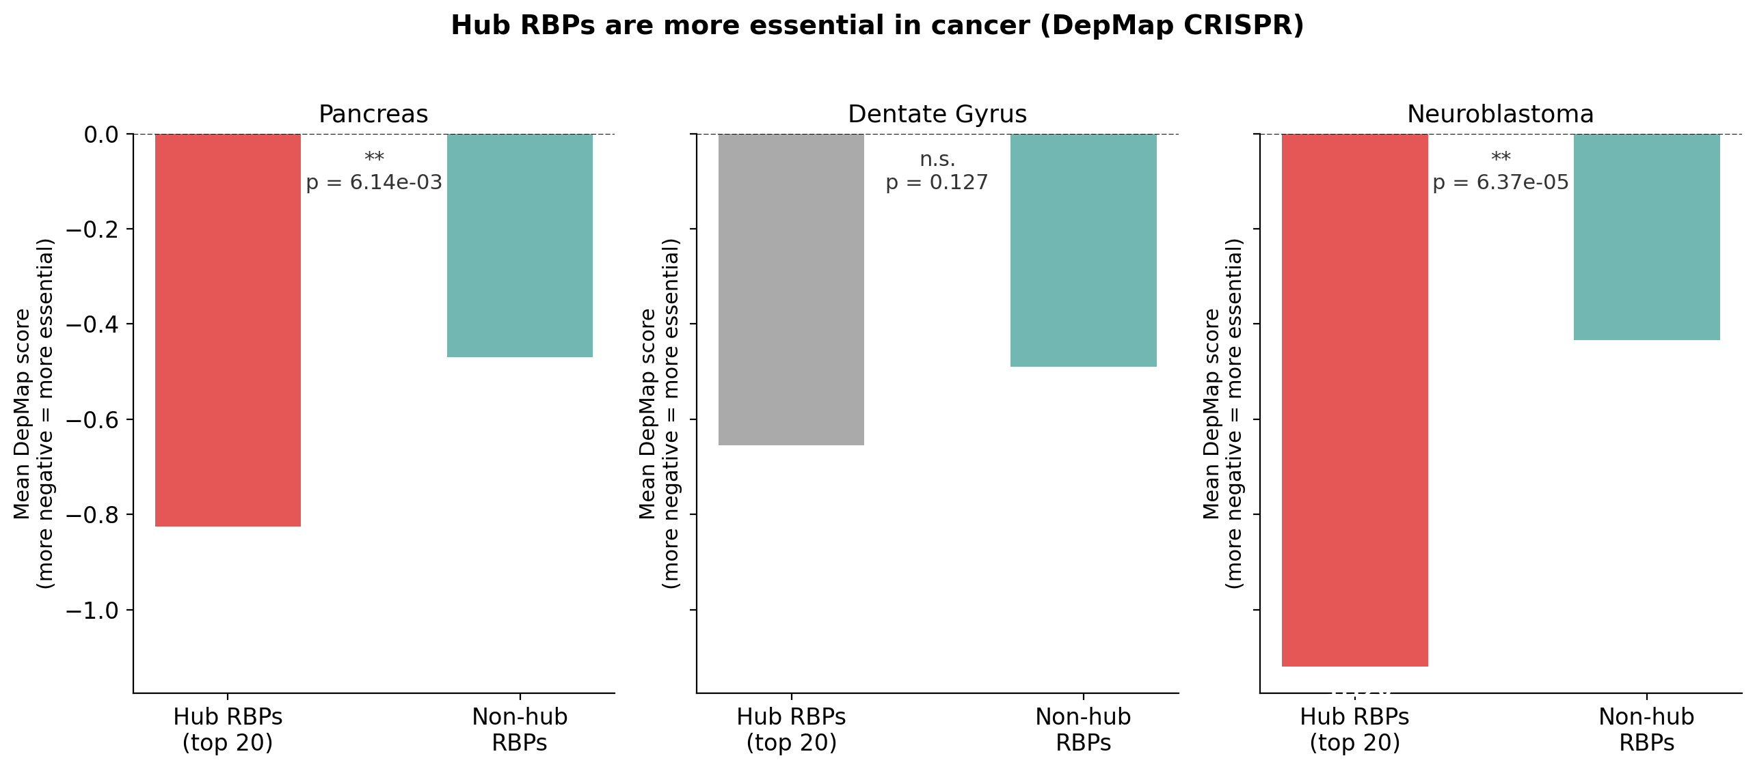
Hub RBPs identified by scPTR are significantly more essential in DepMap CRISPR screens (p=6.4×10⁻⁵).

Slide 21
DeepPTR: an identifiable latent for degradation
A structured NB-VAE with a kinetic decoder that splits the latent into transcriptional (z_{T}) and post-transcriptional (z_{PT}) blocks.
μᵤ is not free — it is fixed by μˢ and z_{PT} through the same kinetic identity, which is what makes z_{PT} identifiable as the degradation axis.
Ablation: the kinetic constraint is key
Variant
half-life ρ
zₚₜ stab.
Full DeepPTR
−0.39
0.94
kinetic → MLP
−0.41
0.42
zₜ, zₚₜ merged
−0.36
0.31
0.94
0.31
NB → Gaussian
−0.29
0.78
zₚₜ stability (split model)
...collapses if zₜ, zₚₜ merged
Notes:
DeepPTR - a generative counterpart. A negative-binomial VAE, but with a kinetic decoder that splits the latent into a transcriptional block and a post-transcriptional block. The trick: the unspliced mean is not predicted freely - it is DETERMINED by the spliced mean and z-PT through the same kinetic identity. That hard constraint makes z-PT identifiable as the degradation axis. The ablation: accuracy on half-lives is matched across variants, all within 0.02 - but replace the kinetic decoder with a free MLP, or merge the latents, and z-PT stability collapses from 0.94 to 0.3-0.4. The value is not accuracy, it is identifiability under noise.

Slide 22
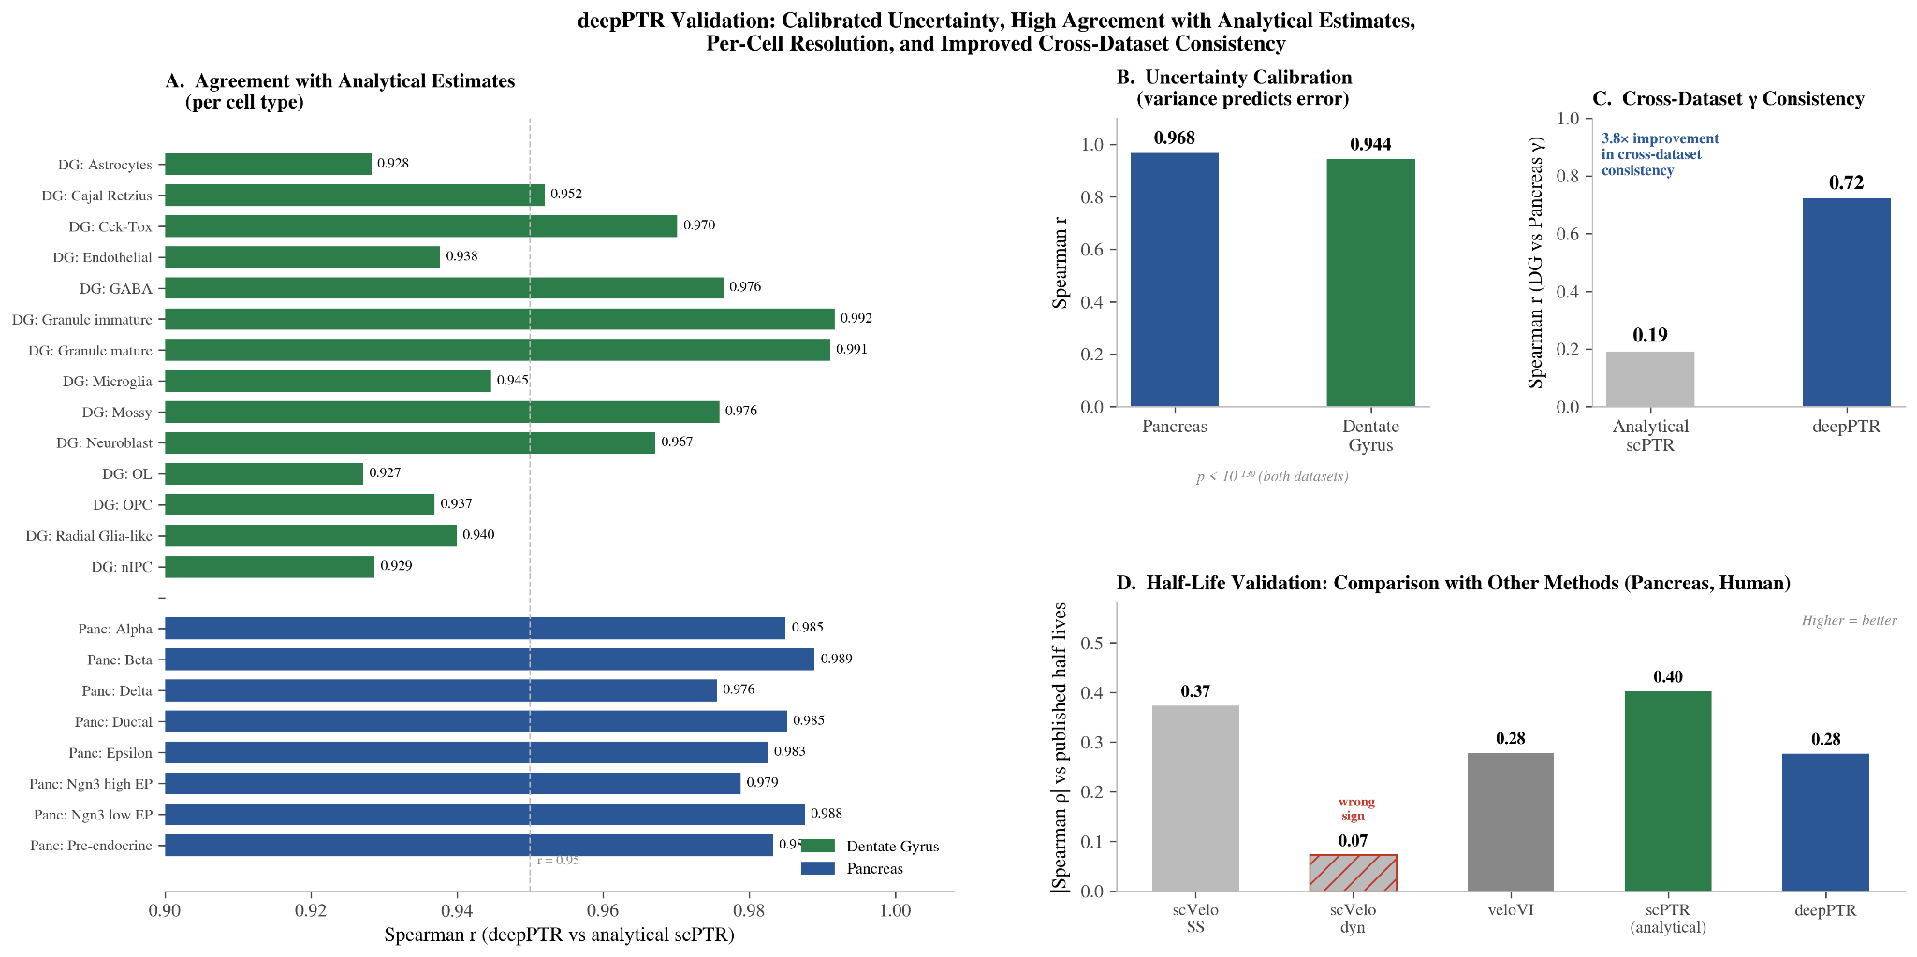

Slide 23
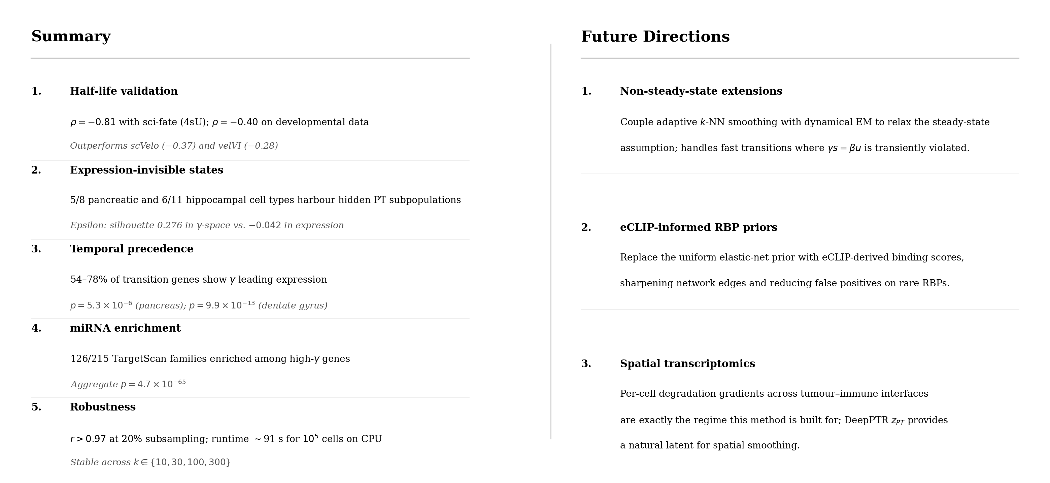
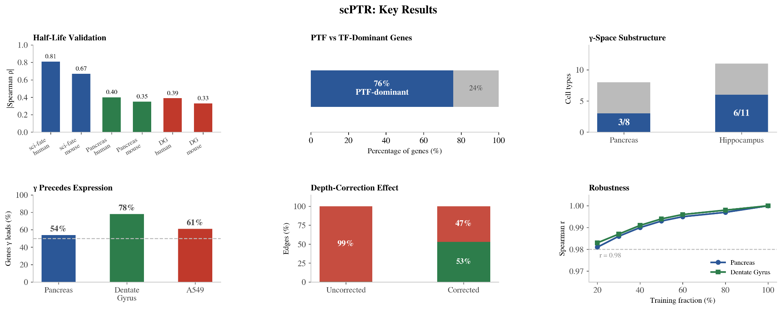
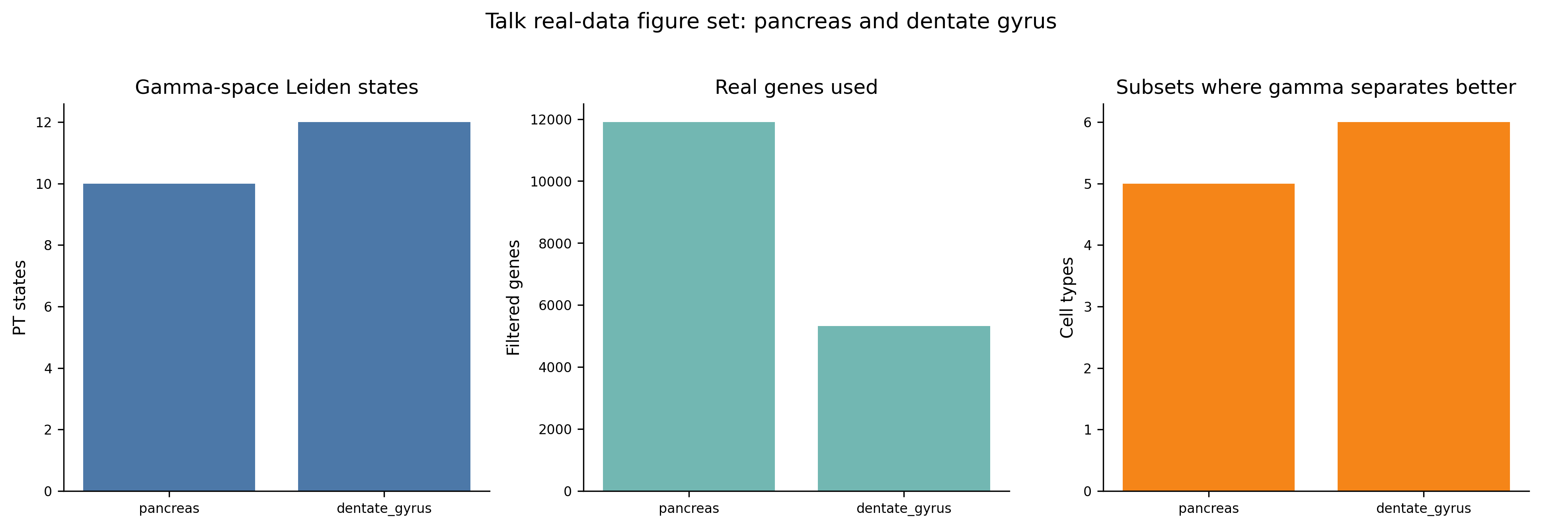
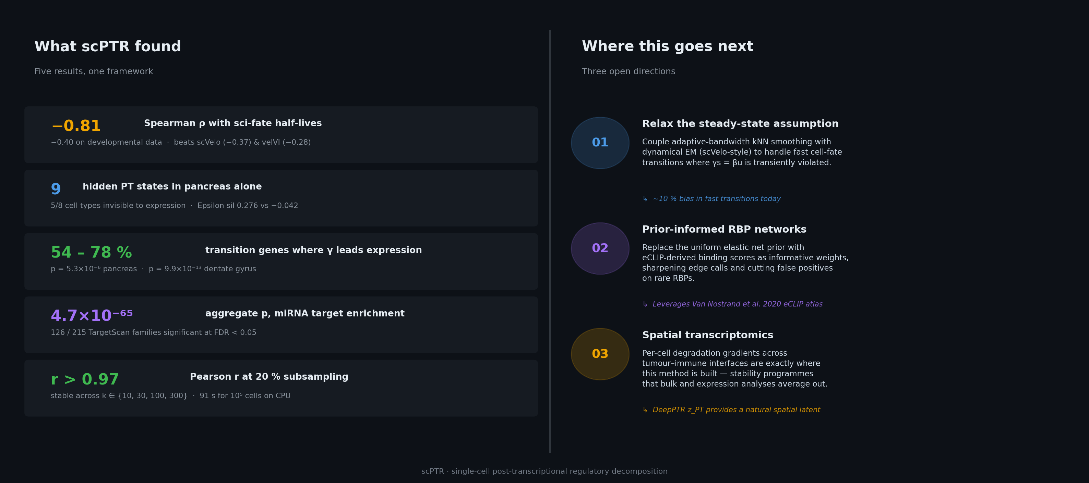
Discussion — results at a glance, and where this goes
Future directions: (1) non-steady-state extensions coupling adaptive smoothing with dynamical EM; (2) eCLIP-informed priors to sharpen RBP-network edges; (3) spatial transcriptomics — stability gradients across tumour–immune interfaces.
Notes:
To put it together and look forward. The recap: gamma correlates minus 0.81 with sci-fate half-lives and minus 0.40 on developmental data; we discover 9 hidden post-transcriptional states in pancreas; 54 to 78 percent of transition genes show gamma leading expression; miRNA enrichment at p equals 4.7 times ten-to-the-minus-65; and the estimates are robust, r above 0.97 at 20 percent subsampling. Where this goes next: first, relaxing the steady-state assumption by coupling our adaptive smoothing with dynamical EM; second, replacing the uniform RBP prior with eCLIP-derived binding scores to sharpen network edges; and third, spatial transcriptomics, where per-cell degradation gradients across tumour-immune interfaces are exactly the regime this method is built for.

Slide 24
Degradation is now a measurable single-cell axis
A biophysically-grounded, CPU-cheap per-cell γ estimator
Dominates scVelo / velVI / UniTVelo on every half-life benchmark (ρ = −0.81)
Unlocks hidden PT states, temporal precedence, and cancer RBP rewiring
DeepPTR adds a generative model with an identifiable degradation latent
Open-source, pip-installable, scanpy/anndata-compatible (scptr.pp / scptr.tl API)
Code, data & reproducibility notebooks: huggingface.co/bryan7264/scPTR
Limitations: steady-state assumption biases fast transitions (~10% in simulations) · sparse chemistries (10x v2) underdetermine rare states — use 10x v3 / higher-depth · residual library-size confounding in RBP inference · cell-cycle bursts violate steady-state (masked, not modeled).
Notes:
To wrap up: scPTR makes mRNA degradation a measurable, per-cell axis from standard scRNA-seq. It is biophysically grounded and runs on a CPU in seconds. It beats every velocity baseline on every half-life benchmark, and unlocks three things expression cannot see - hidden post-transcriptional states, the temporal precedence of decay over expression, and cancer-relevant RBP rewiring. DeepPTR adds a generative model whose degradation latent is identifiable by construction. The full pipeline ships as an open-source, pip-installable, scanpy-compatible package with reproducibility notebooks. Limitations: the steady-state assumption breaks in fast transitions, very sparse chemistries underdetermine rare populations, and some library-size confounding remains. Thank you.

